Slide 1


O-MAF RICHARD GO MSSA SD7 CLOUD APPLICATION DEVELOPMENT
Submit your Maintenance Action Forms Online (O-MAF)
Initiate online
Write discrepancies online even if you are away.
Share with Maintenance Control
Controllers will have access to your MAFs 24/7.

Slide 2
Agenda
1
Situation
Solution
Feature
Process
Step by Step Workflow
Conclusion
2
3
4
5
6

Slide 3


1 Situation
OOMA
O-MAF
Green MAF
Online Maintenance Action Form (O-MAF) for aviation maintenance.
Issues in the aviation field
Computer-based software
Optimized Organizational Maintenance Activity (OOMA)
The problem is whenever the system is down, we are forced to use a paper copy of all our MAF.
There are just too many things to update while the maintenance actions are open and being worked on.
Ordering parts
Personnel going In-Work
Completing the job
After the system comes back online, we have to contingency all the Green MAF and type all the open and closed MAFs to OOMA.
These processes are too time consuming for the workers and for the controllers.

Slide 4
2 Solution
OOMA
O-MAF
Green MAF
Create an online MAF system (Sharepoint)
Mimic the functions of OOMA. Light version.
Eliminate time wasted on the following process:
Writing MAF on paper form (Green MAF)
Managing Green MAFs (Job Status)
M3 – Awaiting Maintenance
IW – In Work
WP – Awaiting Parts
JC – Job Complete
Updating real time status of maintenance by manually writing on the Green MAF
Ordering parts on Green MAF or Hard Copies

Slide 5
3 Features
OOMA
O-MAF
Green MAF
Initiate maintenance
Order parts
In Work
In Process
Update Job Status – must be filtered for management (M3, IW, WP, JC)
Complete maintenance
PN/SN removed/installed
Completed time
Sign authority
Initiator
Worker
CDI always required
QA if required
MC always required
MDS always required

Slide 6
4 Process
OOMA
O-MAF
Green MAF
Daily back up copies of the data.
CSV file downloaded from OOMA
After every shift
Input
Purged data on O-MAF
Upload data to O-MAF
Sorting/Filtering
Sort OPEN MAF by JCN column
Sort OPEN MAF by MCN column
Sort OPEN MAF by Shop
Sort OPEN MAF by Aircraft
Filter Job Status column
Complete and Close MAF.
Authorized signer by qualifications

Slide 7
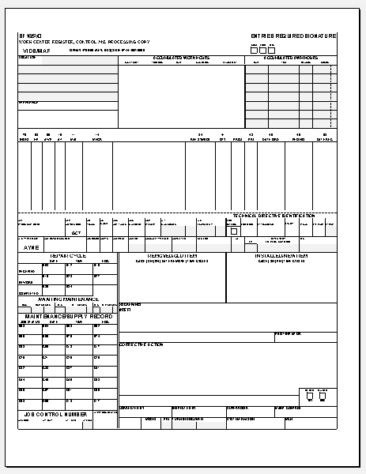
4 Process Cont.
OOMA
O-MAF
Green MAF
Output
Select an MCN
Transfer data to a Digital MAF ready for printing
Open MAF
Closed MAF
Parts ordered
In Process
System is back online
Upload data to OOMA (future feature)
Transfer data to OOMA
Digitally copy and paste

Slide 8

5 Step by Step Workflow
OOMA
O-MAF
Green MAF
1
Initiate MAF
2
MAF gets approved
3
Go InWork on the job. Your progress will be monitored by Maintenance Control.
4
Order Parts if needed
5
Wait for parts
6
Go back InWork
7
Put in your InProcess
8
Complete the Job
9
Sign Off the MAF
10
MC approves the MAF
11
Contingency MAF
12
Admin verify the MAF
Must complete tasks
Optional Process

Slide 9
6 Conclusion
Using O-MAF will enable the controllers to effectively manage all MAFs and set priorities. Efficiency will be increased by 67% based on previous studies done by Certified Lean Six Sigma Green Belt.
Future concept will enable controllers to automatically upload all data from O-MAF to OOMA if permitted by the Navy system administrators.

Slide 10
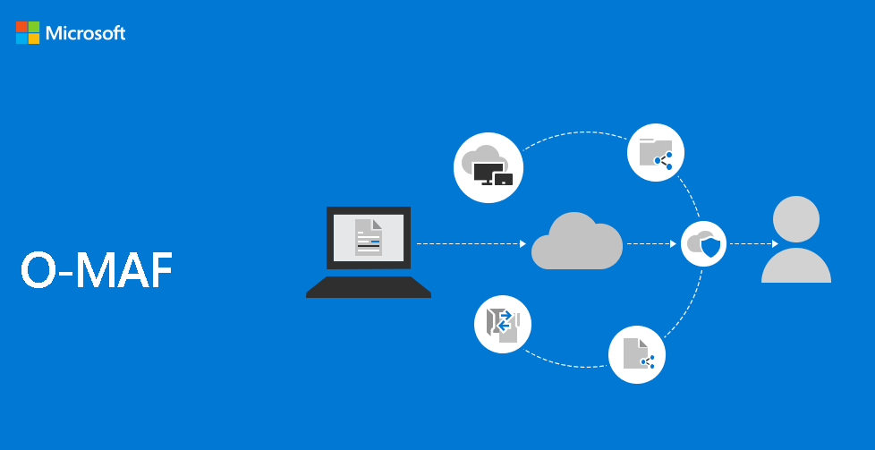
Work in Office/ Online in your browser
OOMA
O-MAF
Green MAF
1
Sign in to www.o-maf.com
2
Initiate, order parts, and sign off MAFs online.
Monitored 24/7 by your Maintenance Controller.
Username
Login
QUESTIONS?

Slide 11
Modify This
Change data to ensure we are keeping security issues.
Buno. Maybe just use the Modex.
Up Down Status. Use codes.

